Slide 1

Python for datascience course
Final project
Screening Alzheimer candidates
Nguyen Thi Huong

Slide 2
Content
Problem
Dataset
Preprocessing
Evaluate algorithm and select model
Present results

Slide 3
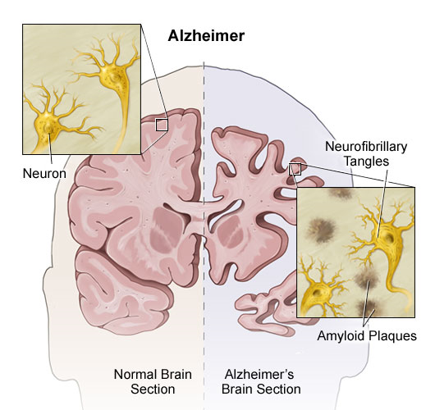
1. Problem
BACE-1

Slide 4
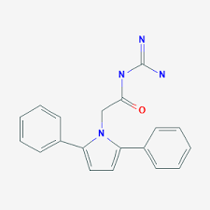
2. Dataset
Similar structure 🡪 similar effect
Construct dataset:
Name, structure, IC50 of BACE-1 inhibitory compounds: collect from ChemBL database
Molecular descriptors (3764): caculate by DRAGON
Molecular descriptors:
nC: 19
nH: 18
nO: 1
Molecule weight: 318.38
…
CHEMBL217068

Slide 5
2. Dataset
Input | Output
Chemical’s descriptors | logIC50
2602 samples and 3766 features:
ID
Name of chemical (inhibit BACE-1)
Chemical’s descriptors
IC50: Inhibitory Concentration (label)

Slide 6
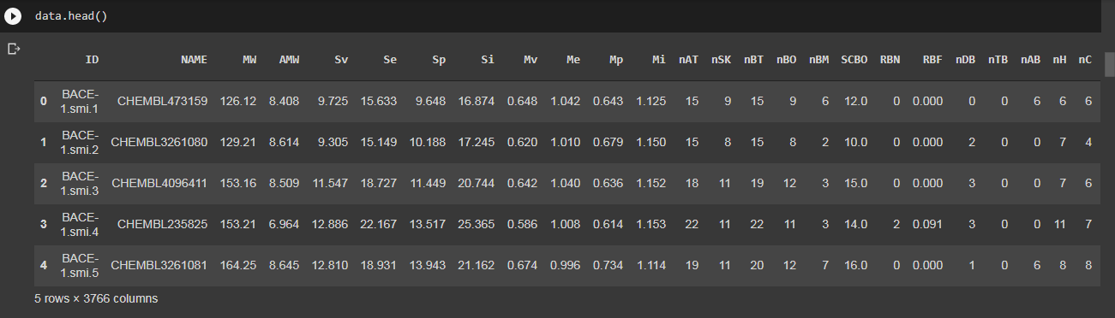
2. Dataset

Slide 7
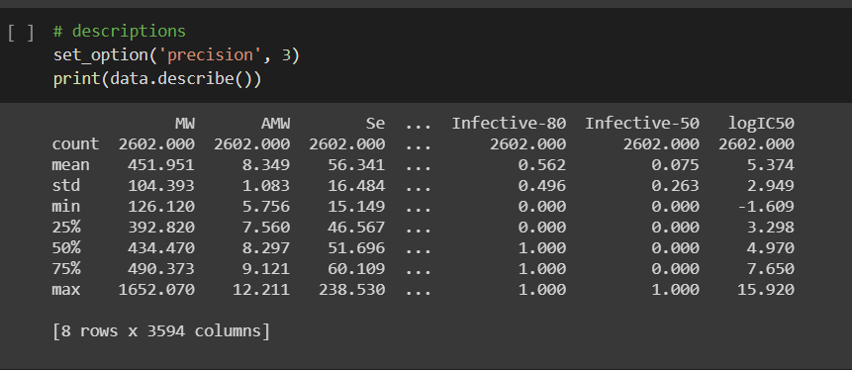
2. Dataset
Summary data

Slide 8
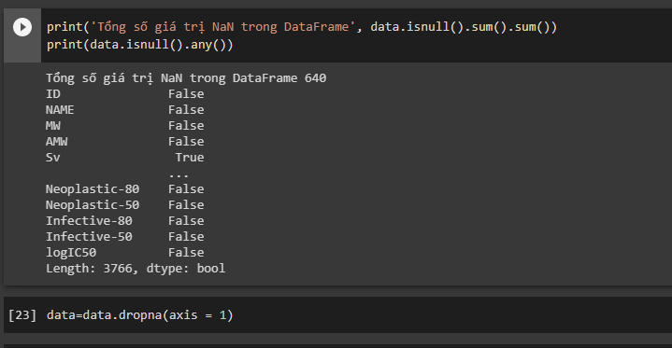
3. Data Pre-processing
Clear features containing NaN
Log(IC50)
Scale data

Slide 9
4. Evaluate algorithm and select model
Algorithm:
Logistic regression (LR)
Lasso (LASSO)
ElasticNet (EN)
KNeighborsRegressor (KNN)
DecisionTreeRegressor (CART)
Support Vector Machine (SVM)
Principal Components Analysis (PCA)

Slide 10
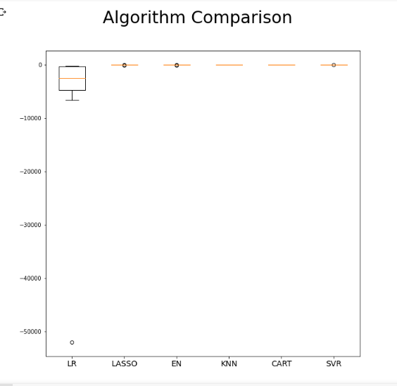
4. Evaluate algorithm and select model

Slide 11
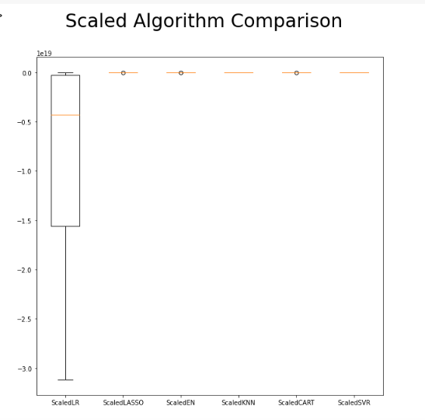
4. Evaluate algorithm and select model

Slide 12
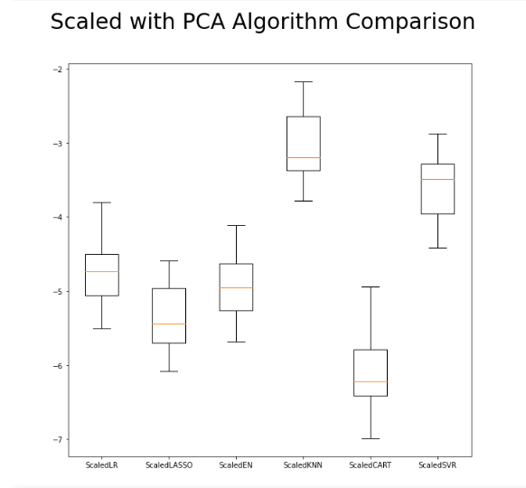
4. Evaluate algorithm and select model
k_neighnor = 3
Standardscale and reduct demensions

Slide 13
4. Evaluate algorithm and select model
Ensemble Algorithm
Boosting:
AdaBoostRegressor (AB)
GradientBoostingRegressor (GBM)
Bagging
RandomForestRegressor (RF)
ExtraTreesRegressor (ET)

Slide 14
4. Evaluate algorithm and select model
Ensemble Algorithm | Cross-val score
AdaBoostRegressor (AB) | -5.15
GradientBoostingRegressor (GBM) | -3.74
RandomForestRegressor (RF) | -3.14
ExtraTreesRegressor (ET) | -2.81

Slide 15
4. Evaluate algorithm and select model
ExtratreesRegressor Algorithm: parameter tuning
n_estimators | 50 | 100 | 150 | 200 | 250
mse | 2.1 | 1.88 | 1.78 | 1.77 | 1.79

Slide 16
4. Evaluate algorithm and select model
Optimal model
Algorithm | Model | mse
ExtraTreesRegressor (ET) | M1 | 1.77
KNeighborsRegressor (KNN) | M2 | 2.32

Slide 17
5. Present results

Slide 18
Thanks for attention
And special thanks to a Tuan ☺

